Slide 1

Socket Programming
Material gathered and synthesized by
Omar Nibouche
Computer Networking: A Top-Down Approach 8th edition n Jim Kurose, Keith Ross Pearson, 2020
Sources used:
Computer Networking: A Top-Down Approach, 8th edition, Jim Kurose, Keith Ross - Pearson, 2020
Foundations of Python Network Programming, 3rd edition, by Brandon Rhodes & John Goerzen, 2014 Apress
A Complete Guide to Socket Programming in Python: https://www.datacamp.com/tutorial/a-complete-guide-to-socket-programming-in-python
Python Socket Programming Tutorial (Tech With Tim): https://www.youtube.com/watch?v=3QiPPX-KeSc&t=3s&ab_channel=TechWithTim
For further reading: please the notes section
Notes:
Further reading:
W. Richard Stevens; Bill Fenner & Andrew M. Rudoff (2003). Unix Network Programming, Volume 1: The Sockets Networking API (3rd ed.). Addison-Wesley Professional.
W. Richard Stevens (1998). Unix Network Programming, Volume 2: Interprocess Communications (2nd ed.). Prentice Hall.
The Youtube channel of Corey Schafer: https://www.youtube.com/@coreyms
Python Socket Tutorial: https://docs.python.org/3.4/library/socket.html
https://code.tutsplus.com/introduction-to-network-programming-in-python--cms-30459t
https://cloudxlab.com/assessment/displayslide/877/network-programming-in-python
‎https://www.scribd.com/presentation/459672333/TCPSocketProgramming-ppt

Slide 2
















Creating a network app
application
transport
network
data link
physical
write programs that:
run on (different) end systems
communicate over network
e.g., web server software communicates with browser software
no need to write software for network-core devices
network-core devices do not run user applications
applications on end systems allows for rapid app development, propagation
mobile network
national or global ISP
local or regional ISP
home network
content
provider
network
application
transport
network
data link
physical
application
transport
network
data link
physical
datacenter
network
enterprise
network

Slide 3

Socket programming
goal: learn how to build client/server applications that communicate using sockets
socket: door between application process and end-end-transport protocol
application
socket
application
controlled by
app developer
process
process
transport
transport
network
network
controlled
by OS
link
Internet
link
physical
physical
Notes:
process sends/receives messages to/from its socket
socket analogous to door
sending process shoves message out door
sending process relies on transport infrastructure on other side of door to deliver message to socket at receiving process
two sockets involved: one on each side

Slide 4
Socket Basics
A network socket is an endpoint of an inter-process communication flow across a computer network.
Sockets may communicate within a process, between processes on the same machine, or between processes on different continents.
Today, most communication between computers is based on the internet protocol; therefore, most network sockets are internet sockets.
Example: to create a connection between machines, Python programs import the socket module, create a socket object, and call the object’s methods to establish connections and send and receive data.
Sockets are the endpoints of a bidirectional communications channel.

Slide 5
Processes communicating
process: program running within a host
within same host, two processes communicate using inter-process communication (defined by OS)
processes in different hosts communicate by exchanging messages
clients, servers
client process: process that initiates communication
server process: process that waits to be contacted
aside: applications with P2P architectures have client processes & server processes

Slide 6
App-layer protocol defines
types of messages exchanged,
e.g., request, response
message syntax:
what fields in messages & how fields are delineated
message semantics
meaning of information in fields
rules for when and how processes send & respond to messages
open protocols:
defined in RFCs(Request for Comments)
allows for interoperability (the basic ability of different computerized products or systems to readily connect and exchange information with one another)
e.g., HTTP, SMTP
proprietary protocols:
e.g., Skype

Slide 7
Addressing processes
to receive messages, process must have identifier
host device has unique 32-bit IP address
Q: does IP address of host on which process runs suffice for identifying the process?
identifier includes both IP address and port numbers associated with process on host.
example port numbers:
HTTP server: 80
mail server: 25
to send HTTP message to gaia.cs.umass.edu web server:
IP address: 128.119.245.12
port number: 80
more shortly…
A: no, many processes can be running on same host

Slide 8
Server and Client
Server and Client exchange messages over the network through a common Socket API
Server
Clients
user
space
ports
TCP/UDP
TCP/UDP
Socket API
kernel
space
IP
IP
Ethernet Adapter
Ethernet Adapter
hardware

Slide 9
Sockets
A socket API is used for communicating between a Client and a Server
Client
Active participant in communication
Initiates conversations and sends data
Server
Passively listens and waits for data
Socket
Protocol to use?
Identifier of the other machine (IP + port)?
Client or server?

Slide 10
Socket programming
Two socket types for two transport services:
UDP: unreliable datagram
TCP: reliable, byte stream-oriented
Application Example:
client reads a line of characters (data) from its keyboard and sends data to server
server receives the data and converts characters to uppercase
server sends modified data to client
client receives modified data and displays line on its screen

Slide 11
Socket programming with UDP
UDP: no “connection” between client and server:
no handshaking before sending data
sender explicitly attaches IP destination address and port # to each packet
receiver extracts sender IP address and port# from received packet
UDP: transmitted data may be lost or received out-of-order
Application viewpoint:
UDP provides unreliable transfer of groups of bytes (“datagrams”) between client and server processes

Slide 12
Client/server socket interaction: UDP
server (running on serverIP)
client
create socket:
create socket, port= x:
clientSocket =
socket(AF_INET,SOCK_DGRAM)
serverSocket =
socket(AF_INET,SOCK_DGRAM)
Create datagram with serverIP address
And port=x; send datagram via clientSocket
read datagram from
serverSocket
write reply to
serverSocket
specifying client address,
port number
read datagram from
clientSocket
close
clientSocket

Slide 13
Example app: UDP client
Python UDPClient
include Python’s socket library
from socket import *
serverName = 'hostname'
serverPort = 12000
clientSocket = socket(AF_INET,
SOCK_DGRAM)
message = input('Input lowercase sentence:')
clientSocket.sendto(message.encode(),
(serverName, serverPort))
modifiedMessage, serverAddress =
clientSocket.recvfrom(2048)
print(modifiedMessage.decode())
clientSocket.close()
create UDP socket
get user keyboard input
attach server name, port to message; send into socket
read reply data (bytes) from socket
print out received string and close socket

Slide 14
Example app: UDP server
Python UDPServer
from socket import *
serverPort = 12000
serverSocket = socket(AF_INET, SOCK_DGRAM)
serverSocket.bind(('', serverPort))
print('The server is ready to receive')
while True:
message, clientAddress = serverSocket.recvfrom(2048)
modifiedMessage = message.decode().upper()
serverSocket.sendto(modifiedMessage.encode(),
clientAddress)
create UDP socket
bind socket to local port number 12000
loop forever
Read from UDP socket into message, getting client’s address (client IP and port)
send upper case string back to this client

Slide 15
Socket programming with TCP
Client must contact server
server process must first be running
server must have created socket (door) that welcomes client’s contact
Client contacts server by:
Creating TCP socket, specifying IP address, port number of server process
when client creates socket: client TCP establishes connection to server TCP
when contacted by client, server TCP creates new socket for server process to communicate with that particular client
allows server to talk with multiple clients
client source port # and IP address used to distinguish clients (more in Chap 3)
Application viewpoint
TCP provides reliable, in-order
byte-stream transfer (“pipe”)
between client and server processes

Slide 16
Client/server socket interaction: TCP
server (running on hostid)
client
create socket,
port=x, for incoming request:
serverSocket = socket()
wait for incoming
connection request
TCP
connection setup
create socket,
connect to hostid, port=x
connectionSocket =
serverSocket.accept()
clientSocket = socket()
send request using
clientSocket
read request from
connectionSocket
write reply to
connectionSocket
read reply from
clientSocket
close
connectionSocket
close
clientSocket
Notes:
Both the server and client first create a socket to communicate with other processes. To create a socket, we use the socket() method.
Server needs to bind its socket to a specific port and IP. This port and IP will be used by the server to send and receive messages. Use the bind() method to bind the socket.
After binding to a defined port and IP, the server needs to listen for incoming connections or messages at this port and IP. Use the listen() method to listen through the socket.
For a client to communicate with the server, it first needs to connect to it. Use the connect() method to connect to a port and IP.

Slide 17
Example app: TCP client
Python TCPClient
from socket import *
serverName = 'servername'
serverPort = 12000
clientSocket = socket(AF_INET, SOCK_STREAM)
clientSocket.connect((serverName,serverPort))
sentence = input('Input lowercase sentence:')
clientSocket.send(sentence.encode())
modifiedSentence = clientSocket.recv(1024)
print ('From Server:', modifiedSentence.decode())
clientSocket.close()
create TCP socket for server, remote port 12000
No need to attach server name, port

Slide 18
Example app: TCP server
Python TCPServer
from socket import *
serverPort = 12000
serverSocket = socket(AF_INET,SOCK_STREAM)
serverSocket.bind(('',serverPort))
serverSocket.listen(1)
print('The server is ready to receive')
while True:
connectionSocket, addr = serverSocket.accept()
sentence = connectionSocket.recv(1024).decode()
capitalizedSentence = sentence.upper()
connectionSocket.send(capitalizedSentence.
encode())
connectionSocket.close()
create TCP welcoming socket
server begins listening for incoming TCP requests
loop forever
server waits on accept() for incoming requests, new socket created on return
read bytes from socket (but not address as in UDP)
close connection to this client (but not welcoming socket)

Slide 19
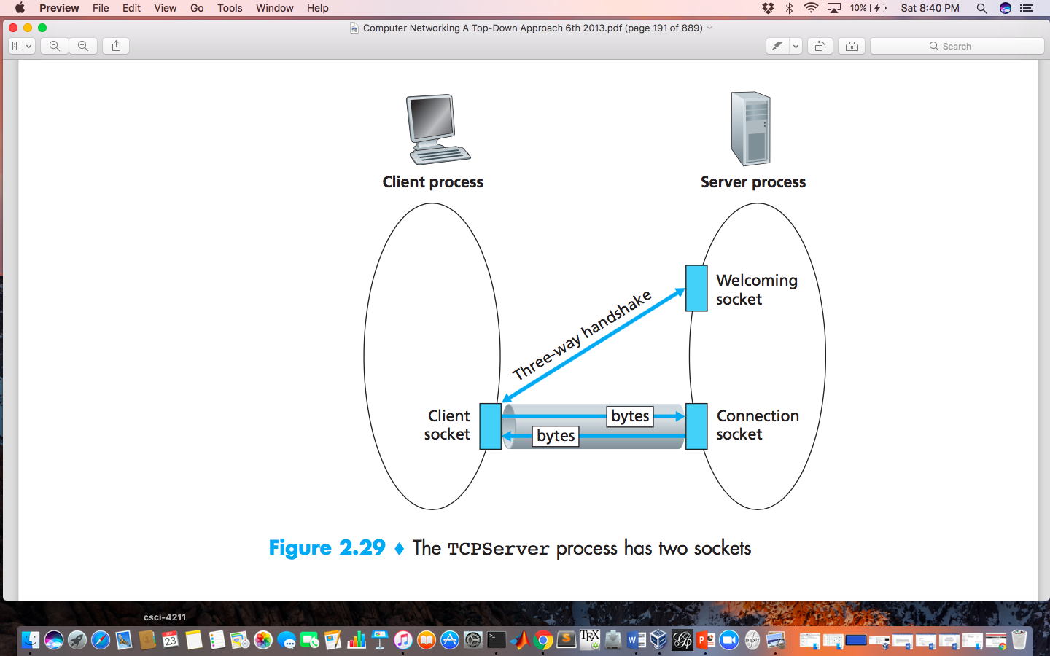
Socket programming with TCP
client must contact server
server process must first be running
server must have created socket (door) that welcomes client’s contact
client contacts server by:
Creating TCP socket, specifying IP address, port number of server process
when client creates socket: client TCP establishes connection to server TCP

Slide 20
Socket programming with TCP
when contacted by client, server TCP creates new socket for server process to communicate with that particular client
allows server to talk with multiple clients
source port numbers used to distinguish clients (more in Chap 3)
application viewpoint:
TCP provides reliable, in-order
byte-stream transfer (“pipe”)
between client and server

Slide 21

Socket programming: waiting for multiple events
sometimes a program must wait for one of several events to happen, e.g.,:
wait for either (i) a reply from another end of the socket, or (ii) timeout: timer
wait for replies from several different open sockets: select(), multithreading
timeouts are used extensively in networking
using timeouts with Python socket:
receive a message
socket()
connect()
send()
settimeout()
recv()
…
timeout
throw exception
handle timeout
…
Show example: connect wordle client to random port, it will freeze.
handle exception
Notes:
This is going to be something new for some students. Interruption-driven programming, timeout.

Slide 22
How Python socket.settimeout() works?
timer starts!
no packet arrives in 30 secs
timeout
s.settimeout(30)
s.recv()
interrupt s.recv() &
raise timeout exception
receive a message
& timer stop!
no packet arrives in 10 secs
timer starts!
timer starts!
timeout
s.settimeout(10)
s.recv()
s.recv()
interrupt s.recv() &
raise timeout exception
Set a timeout on all future socket operations of that specific socket!

Slide 23

Socket programming: socket timeouts
Toy Example:
Python TCPServer (Villagers)
- A shepherd boy tends his master’s sheep.
- If he sees a wolf, he can send a message to villagers for help using a TCP socket.
- The boy found it fun to connect to the server without sending any messages. But the villagers don’t think so.
- And they decided that if the boy connects to the server and doesn’t send the wolf location within 10 seconds for three times, they will stop listening to him forever and ever.
from socket import *
serverPort = 12000
serverSocket = socket(AF_INET,SOCK_STREAM)
serverSocket.bind(('',serverPort))
serverSocket.listen(1)
counter = 0
while counter < 3:
connectionSocket, addr = serverSocket.accept()
connectionSocket.settimeout(10)
try:
wolf_location = connectionSocket.recv(1024).decode()
send_hunter(wolf_location) # a villager function
connectionSocket.send('hunter sent')
except timeout:
counter += 1
connectionSocket.close()
set a 10-seconds timeout on all future socket operations
timer starts when recv() is called and will raise timeout exception if there is no message within 10 seconds.
catch socket timeout exception
How to remove settimeout()?
Use settimeout(None). settimeout(0) will result in changing the socket to non-blocking mode.
Notes:
Talk a bit about real-world examples for timeout at the end.
Question: settimeout(10), then what happens in the next iteration? Will .accept() have timeout?
Non-blocking:
https://www.scottklement.com/rpg/socktut/nonblocking.html

Slide 24
Socket in Python
Python provides two levels of access to network services. At a low level, you can access the basic socket support in the underlying operating system, which allows you to implement clients and servers for both connection-oriented and connectionless protocols.
Python also has libraries that provide higher level access to specific application level network protocols, such as FTP, HTTP, SMTP, and so on.
Sockets may be implemented over a number of different channel types: UNIX domain sockets, TCP, UDP, and so on.
The socket library provides specific classes for handling the common transports as well as a generic interface for handling the rest.

Slide 25
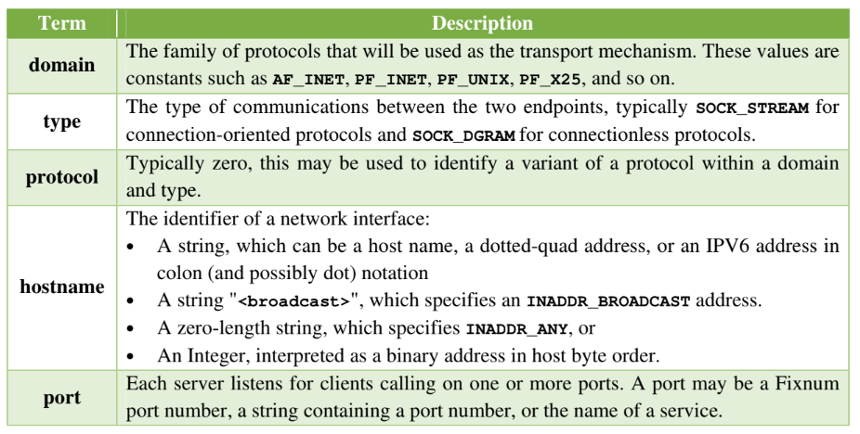
Vocabulary of Sockets

Slide 26
The socket Module
To create a socket, you must use the socket.socket() function available in socket module, which has the general syntax:
s = socket.socket (socket_family, socket_type, protocol=0)
Here is the description of the parameters:
socket_family: This is either AF_UNIX or AF_INET, as explained earlier.
socket_type: This is either SOCK_STREAM or SOCK_DGRAM.
protocol: This is usually left out, defaulting to 0.
Once you have socket object, then you can use required functions to create your client or server program.

Slide 27
The socket Module
To create a socket, you must use the socket.socket() function available in socket module, which has the general syntax
Here is the description of the parameters −
socket_family − This is either AF_UNIX or AF_INET, as explained earlier.
socket_type − This is either SOCK_STREAM or SOCK_DGRAM.
protocol − This is usually left out, defaulting to 0.
s = socket.socket (socket_family, socket_type, protocol=0)

Slide 28
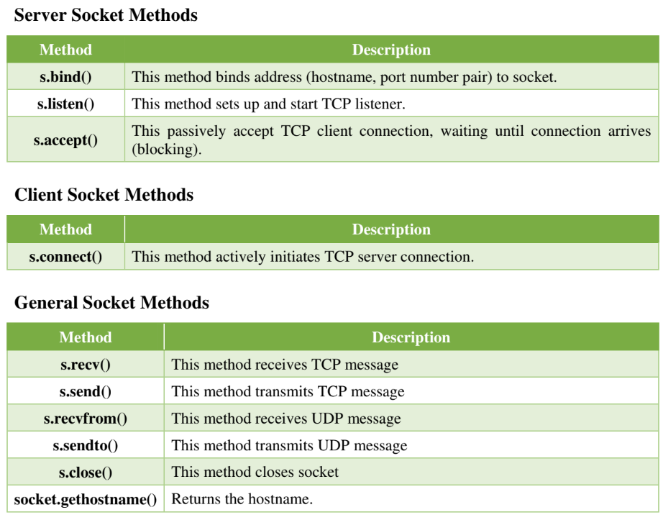

Slide 29
Server Socket Methods
Once you have socket object, then you can use required functions to create your client or server program. Following is the list of functions required
Method & Description
s.bind() This method binds address (hostname, port number pair) to socket.
s.listen() This method sets up and start TCP listener.
s.accept() This passively accept TCP client connection, waiting until connection arrives (blocking).

Slide 30
Server and Client Socket Methods
Server
Client
Method & Description
s.bind() This method binds address (hostname, port number pair) to socket.
s.listen() This method sets up and start TCP listener.
s.accept() This passively accept TCP client connection, waiting until connection arrives (blocking).
Method & Description
s.connect() This method actively initiates TCP server connection.

Slide 31
General Socket Methods
Method & Description
s.recv() This method receives TCP message
s.send() This method transmits TCP message
s.recvfrom() This method receives UDP message
s.sendto() This method transmits UDP message
s.close() This method closes socket
socket.gethostname() Returns the hostname.

Slide 32
A Simple Server
To write Internet servers, we use the socket function available in socket module to create a socket object.
A socket object is then used to call other functions to setup a socket server.
Now call bind(hostname, port) function to specify a port for your service on the given host.
Next, call the accept method of the returned object. This method waits until a client connects to the port you specified, and then returns a connection object that represents the connection to that client.

Slide 33
#!C:\Python33\python.exe
# Echo server program
import socket
host = socket.gethostname()
port = 12345
s = socket.socket()
s.bind((host, port))
s.listen(5)
conn, addr = s.accept()
print('Got connection from ', addr[0], '(', addr[1], ')')
print('Thank you for connecting')
while True:
data = conn.recv(1024)
if not data: break
conn.sendall(data)
conn.close()

Slide 34
A Simple Client
Now we will write a very simple client program which will open a connection to a given port 12345 and given host.
This is very simple to create a socket client using Python's socket module function.
The socket.connect(hosname, port ) opens a TCP connection to hostname on the port.
Once you have a socket open, you can read from it like any IO object. When done, remember to close it, as you would close a file.
The following code is a very simple client that connects to a given host and port, reads any available data from the socket, and then exits:

Slide 35
#!C:\Python33\python.exe
# Echo client program
import socket
host = socket.gethostname()
port = 12345
s = socket.socket()
s.connect((host, port))
s.sendall(b'Welcome User!')
data = s.recv(1024)
s.close()
print(repr(data))

Slide 36
Now run this server.py in background and then run above client.py to see the result.
Output:
Step 1: Run server.py. It would start a server in background.
Step 2: Run client.py. Once server is started run client.
Step 3: Output of server.py generates as follows:
C:\Users\Ashok Kumar\Desktop>python server.py
Got connection from 192.168.3.21 ( 61428 )
Thank you for connecting
Step 4: Output of client.py generates as follows:
C:\Users\Ashok Kumar\Desktop>python clients.py
b'Welcome User!'

Slide 37
UDP Server
Example for UDP server
import socket
UDP_IP = "127.0.0.1"
UDP_PORT = 5005
sock = socket.socket(socket.AF_INET, # Internet
socket.SOCK_DGRAM) # UDP
sock.bind((UDP_IP, UDP_PORT))
while True:
data, addr = sock.recvfrom(1024) # buffer size is 1024 bytes
print("received message: %s" % data)

Slide 38
UDP Client
Example for UDP client
import socket
UDP_IP = "127.0.0.1"
UDP_PORT = 5005
MESSAGE = b"Hello, World!"
print("UDP target IP: %s" % UDP_IP)
print("UDP target port: %s" % UDP_PORT)
print("message: %s" % MESSAGE)
sock = socket.socket(socket.AF_INET, # Internet
socket.SOCK_DGRAM) # UDP
sock.sendto(MESSAGE, (UDP_IP, UDP_PORT))

Slide 39
Transferring Files using UDP
Simple approach
On the client side,
Reading the file as one variable
Sending the file as one UDP packet
On the server side,
read the data from the socket
store the data into a file

Slide 40
Example: Transferring Files UDP Server
Example for UDP file transfer server
import socket
import time
UDP_IP = "127.0.0.1"
UDP_PORT = 5005
sock = socket.socket(socket.AF_INET, # Internet
socket.SOCK_DGRAM) # UDP
sock.bind((UDP_IP, UDP_PORT))
data, addr = sock.recvfrom(1024) # buffer size is 1024 bytes
f = open("output.txt","w")
f.write(data.decode())
f.close()
print("received message from:" , addr)

Slide 41
Example: Transferring Files UDP Client
Example for UDP file transfer client
import socket
UDP_IP = "127.0.0.1"
UDP_PORT = 5005
print("UDP target IP: %s" % UDP_IP)
print("UDP target port: %s" % UDP_PORT)
f = open("input.txt","r")
file_data = f.read()
sock = socket.socket(socket.AF_INET, # Internet
socket.SOCK_DGRAM) # UDP
sock.sendto(file_data.encode(), (UDP_IP, UDP_PORT))

Slide 42
Example: Transferring Files UDP
Simple approach works well with small files
Does not work with large files
What is the limit?
consider the UDP datagram maximum length.
2^16 = 65536 bytes
16 = the number of bits allocated for the packet length
What is the solution?

Slide 43
Example: Transferring Files UDP
Better approach
On the client side,
Reading the file as data chunks of small size
For example, 100 bytes
Using while loop
send each chunk until the last chunk
On the server side,
Reading all chunks from the socket
Append all data chunks into the output file

Slide 44
Example: Transferring Files UDP Server
Example for UDP file transfer server
import socket
UDP_IP = "127.0.0.1"
UDP_PORT = 5005
sock = socket.socket(socket.AF_INET, # Internet
socket.SOCK_DGRAM) # UDP
sock.bind((UDP_IP, UDP_PORT))
f = open("output.txt","w")
chunk_size = 10
data = "buffer"
while True:
data, addr = sock.recvfrom(chunk_size)
if data.decode() == "":
break
print("received chunk from:" , addr)
f.write(data.decode())
f.close()

Slide 45
Example: Transferring Files UDP Client
Example for UDP file transfer client
import socket
UDP_IP = "127.0.0.1"
UDP_PORT = 5005
print("UDP target IP: %s" % UDP_IP)
print("UDP target port: %s" % UDP_PORT)
f = open("input.txt","r")
chunk_size = 10
file_data = f.read(chunk_size)
sock = socket.socket(socket.AF_INET, socket.SOCK_DGRAM)
while file_data:
sock.sendto(file_data.encode(), (UDP_IP, UDP_PORT))
file_data = f.read(chunk_size)
sock.sendto(b"", (UDP_IP, UDP_PORT))

Slide 46
Socket programming with TCP
client must contact server
server process must first be running
server must have created socket (door) that welcomes client’s contact
client contacts server by:
Creating TCP socket, specifying IP address, port number of server process
when contacted by client, server TCP creates new socket for server process to communicate with that particular client
allows server to talk with multiple clients
source port numbers used to distinguish clients
application viewpoint:
TCP provides reliable, in-order byte-stream transfer (“pipe”) between client and server

Slide 47
Simple TCP Server
Example for TCP file transfer server
import socket # Import socket module
s = socket.socket(socket.AF_INET, # Internet
socket.SOCK_STREAM) # tcp
host = ""
port = 12345 # Reserve a port for your service.
s.bind((host, port)) # Bind to the port
s.listen(5) # Now wait for client connection.
while True:
c, addr = s.accept() # Establish connection with client.
print ("Got connection from", addr)
msg = c.recv(1024)
print (msg.decode())
c.close() # Close the connection

Slide 48
Simple TCP Client
Example for TCP file transfer client
import socket # Import socket module
s = socket.socket(socket.AF_INET, # Internet
socket.SOCK_STREAM) # tcp
host = "127.0.0.1" # Get local machine name
port = 12345 # Reserve a port for your service.
s.connect((host, port))
s.send(b"Hello There from Client")
s.close() # Close the socket when done

Slide 49
Example: Transferring Files TCP Server
Example for TCP file transfer server
import socket # Import socket module
s = socket.socket(socket.AF_INET, # Internet
socket.SOCK_STREAM) # tcp
host = ""
port = 12345 # Reserve a port for your service.
s.bind((host, port)) # Bind to the port
s.listen(5) # Now wait for client connection.
while True:
c, addr = s.accept() # Establish connection with client.
print ("Got connection from", addr)
f = open("output.txt","w")
data = c.recv(65000)
f.write(data.decode())
f.close()
c.close() # Close the connection

Slide 50
Example: Transferring Files TCP Client
Example for TCP file transfer client
import socket # Import socket module
s = socket.socket(socket.AF_INET, # Internet
socket.SOCK_STREAM) # tcp
host = "127.0.0.1" # Get local machine name
port = 12345 # Reserve a port for your service.
addr = (host, port)
s.connect(addr)
f = open("input.txt","r")
file_data = f.read()
s.send(file_data.encode())
s.close() # Close the socket when done

